Slide 1
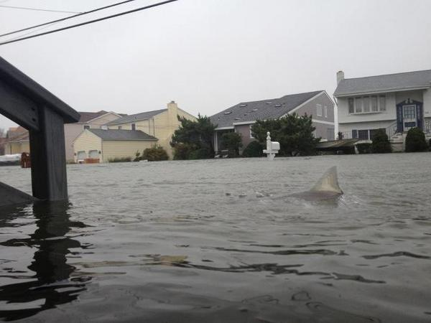
VIRAL PHOTOS:
REAL OR FAKE?

Slide 2
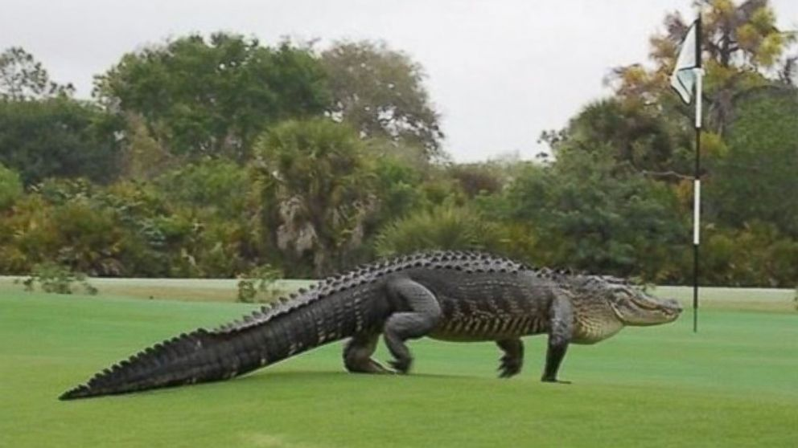

Slide 3
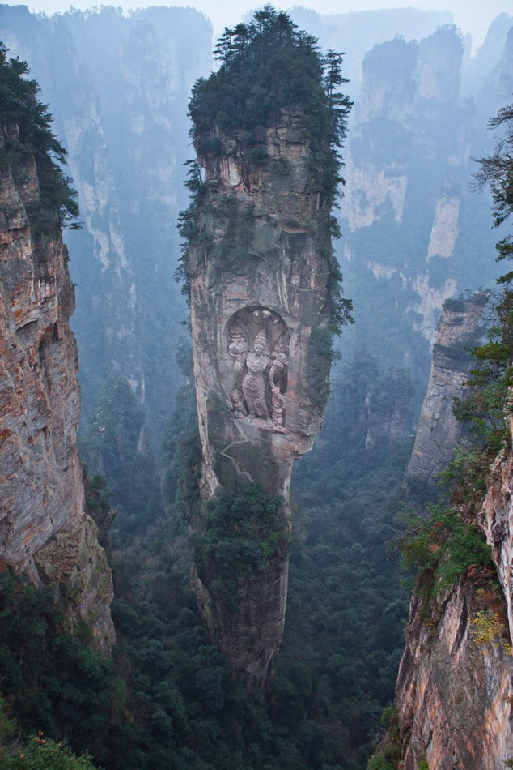

Slide 4
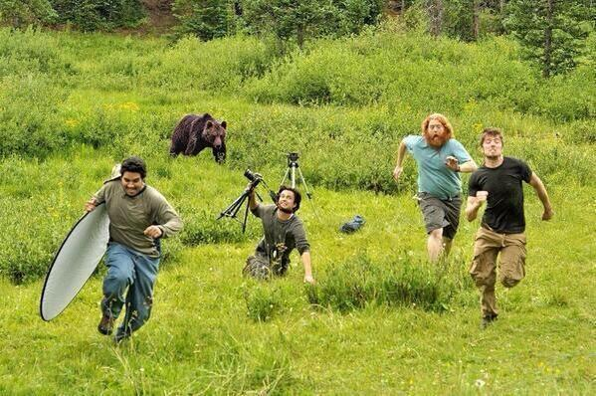

Slide 5
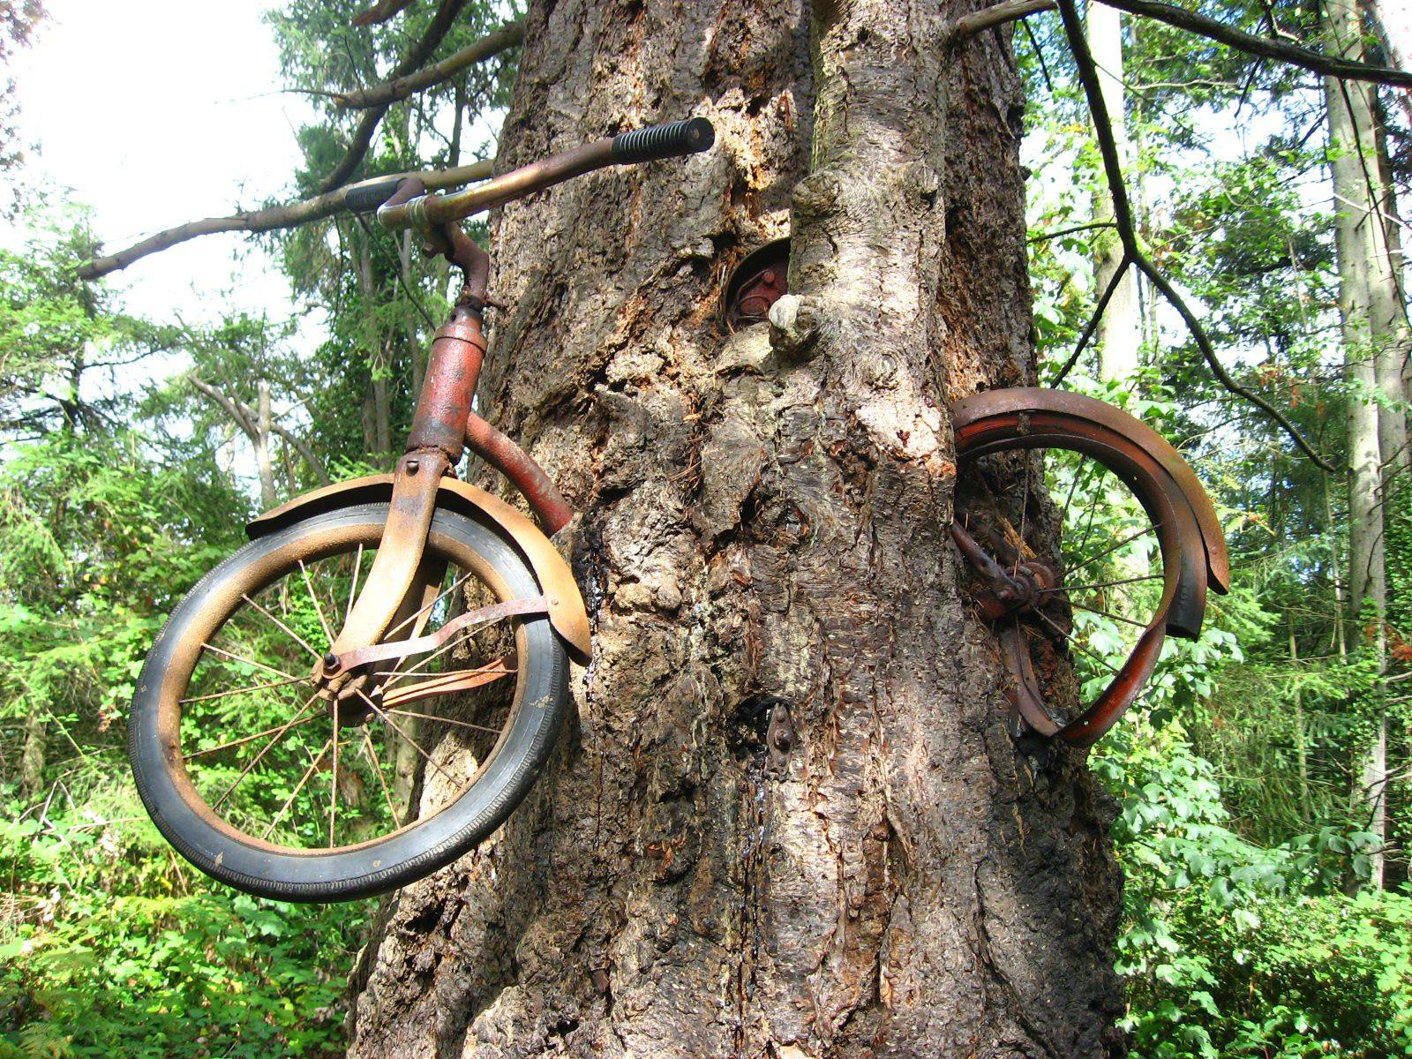

Slide 6
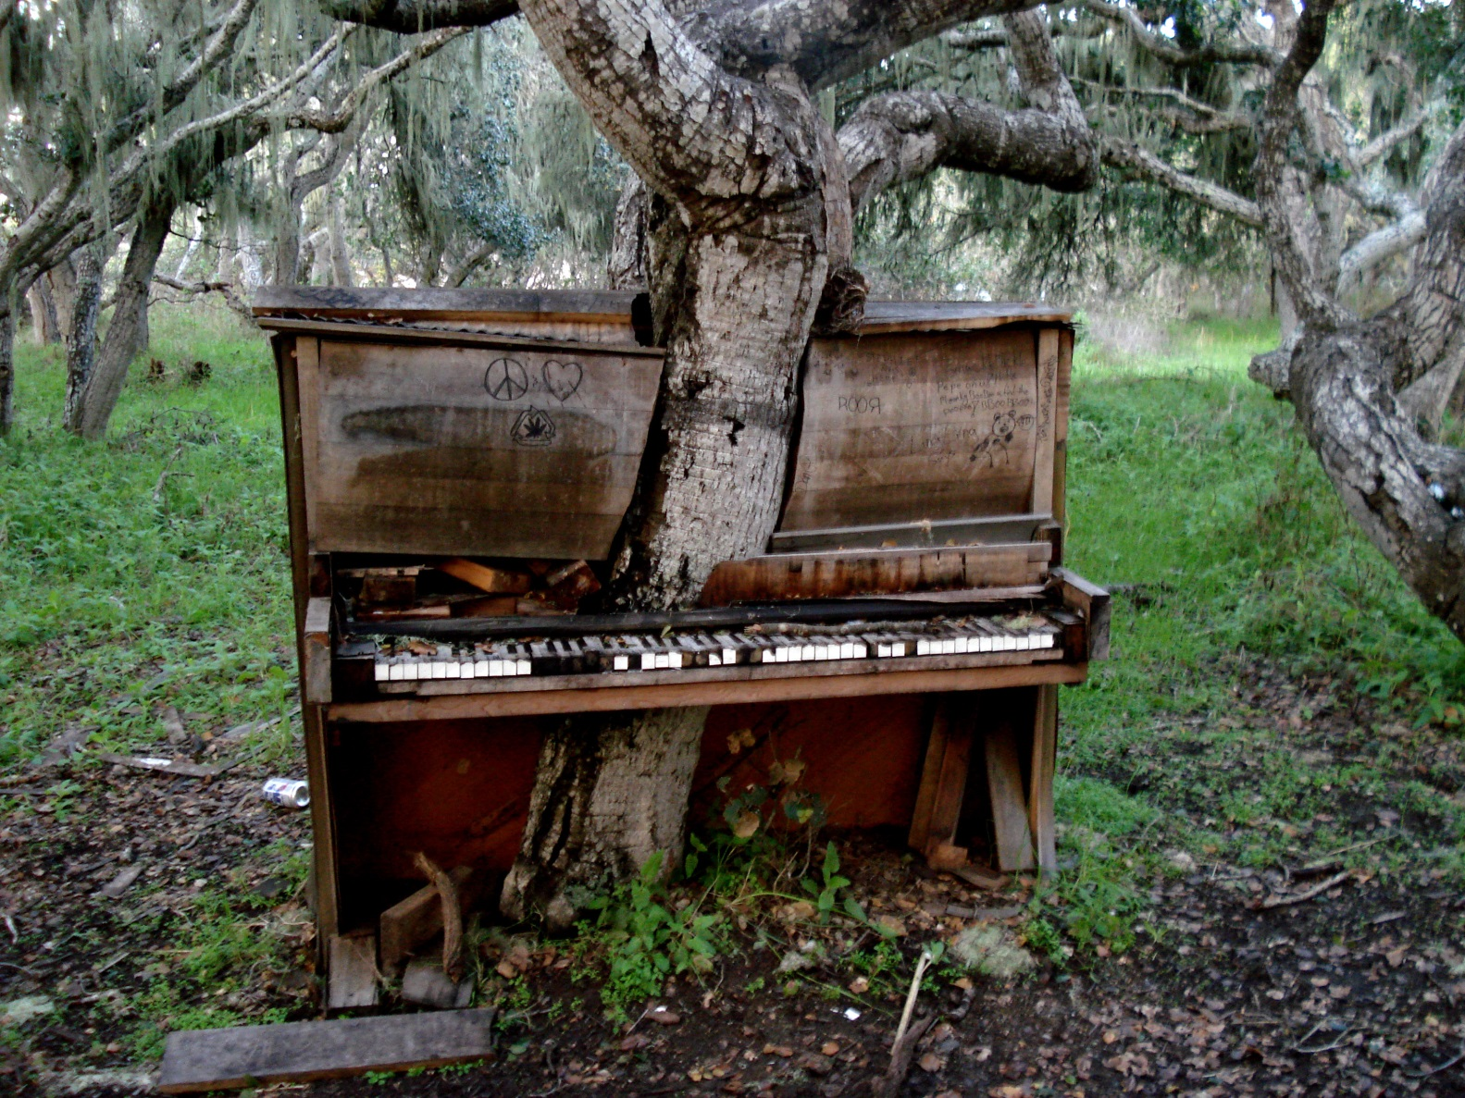

Slide 7
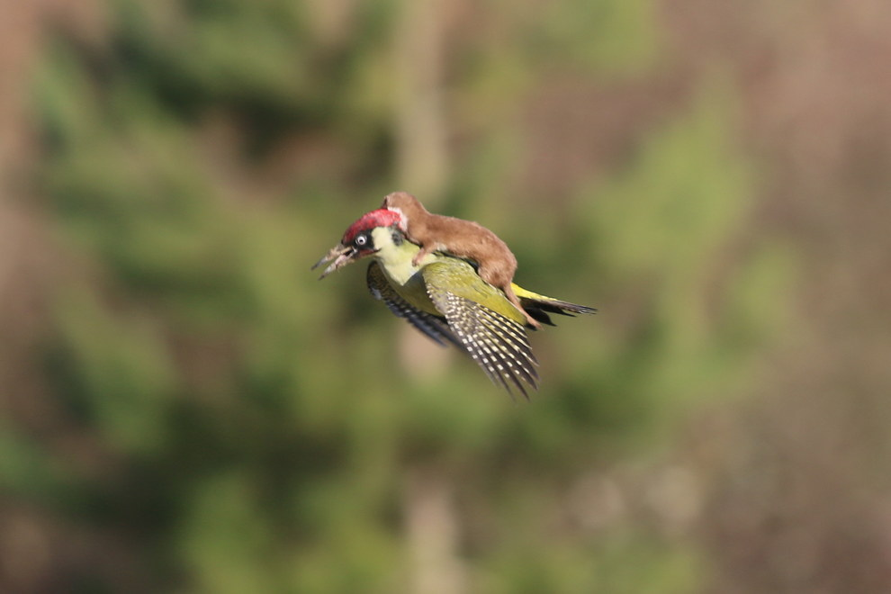

Slide 8
WHICH ARE FAKE?
WHICH ARE REAL?
HOW DO YOU KNOW?

Slide 9
REAL
Notes:
This is a real alligator, photographed on a golf course in Florida.

Slide 10
FAKE
Notes:
This mountain is real, but the statue was added by Photoshop.

Slide 11
FAKE
Notes:
This photo is entirely staged, with the bear added by Photoshop.

Slide 12
REAL
Notes:
This really is a bicycle that got stuck in a tree that grew around it, in Washington state. However, many people mistakenly claim that it has been there since World War I: in fact it was left there around 1954.

Slide 13
FAKE
Notes:
The tree and the piano are real – but the piano was taken apart and re-assembled around the tree by an artist.

Slide 14
REAL
Notes:
This photo really does capture a weasel riding on the back of a woodpecker – probably in an attempt to kill it. The woodpecker threw the weasel off moments later and escaped.

Slide 15
WHY DOES IT MATTER?

Slide 16
REAL

Slide 17
FAKE
Notes:
This doctored photo of an Iranian missile test was released by the Iranian government.

Slide 18
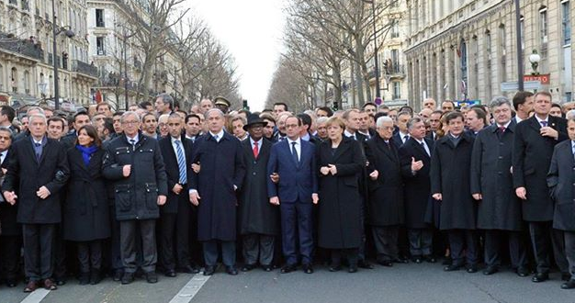
REAL

Slide 19
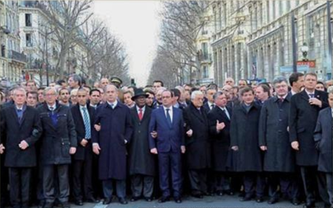
FAKE
Notes:
All the women – including German chancellor Angela Merkel – were removed from this photo when it was printed in the conservative Orthodox Israeli paper The Announcer.

Slide 20
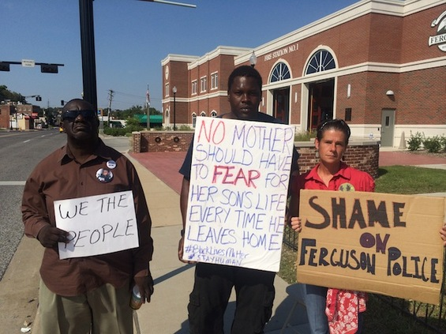
REAL

Slide 21
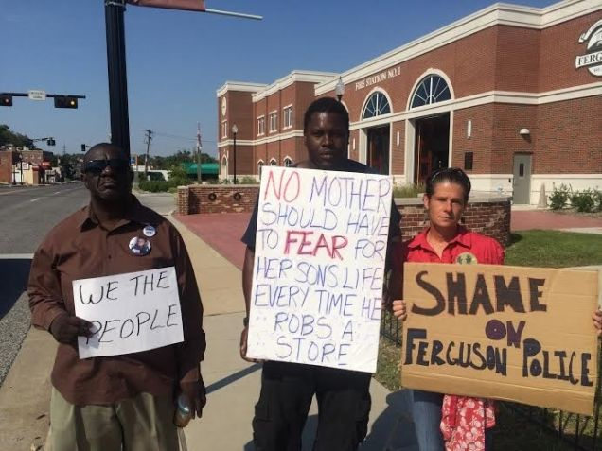
FAKE
Notes:
This photo of a protestor in Ferguson, Missouri, was altered to spread a racist message.

Slide 22
FACT-CHECK IT!

Slide 23
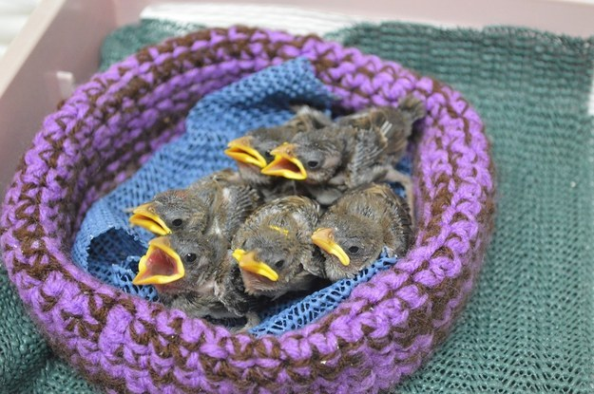
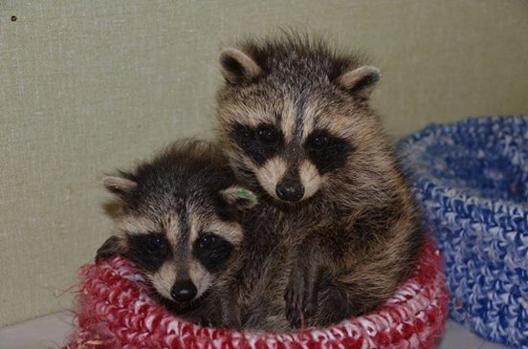
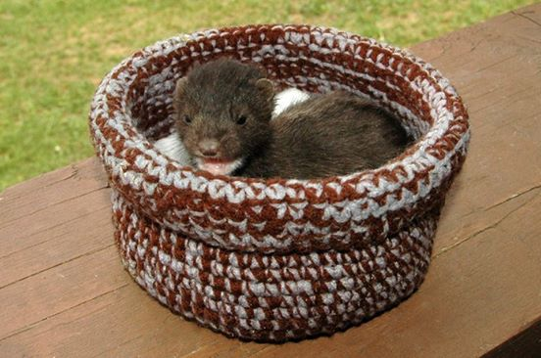
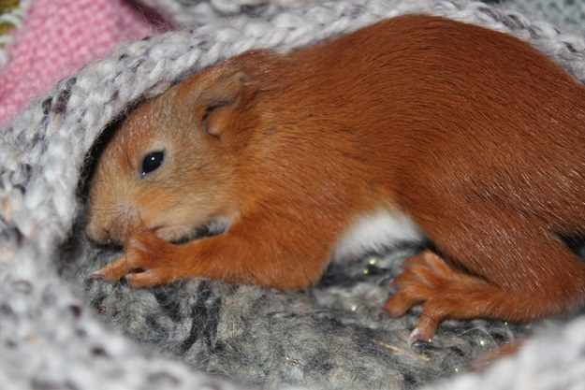

Slide 24
Questions:
1. Does it use loaded language?
2. Are they trying to get me to buy or believe something?
3. Who is spreading it?
4. Is there a source given?
5. Does it seem “too good to be true”?

Slide 25
1. Does it use loaded language?
A. No. The story is cute but the language is fairly plain.

Slide 26
2. Are they trying to get me to buy or believe something?
A. No. There’s a link to a knitting pattern in the story, but it’s free.

Slide 27
3. Who is spreading it?
BuzzFeed – a legitimate site that has a history of spreading “news” stories without fact-checking.

Slide 28
4. Is there a source given?
A. Yes: The Wildlife Rescue Nests Facebook page, which leads to a webpage. Neither one has contact information.

Slide 29
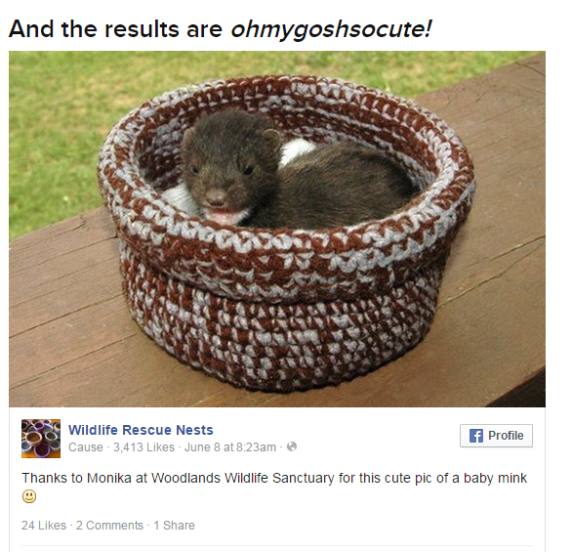
4. Does it seem “too good to be true”?
A. Kind of…

Slide 30
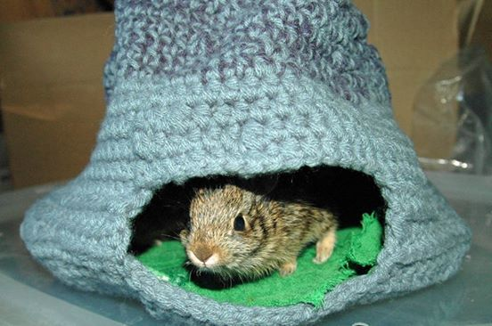
Let’s dig a little deeper…

Slide 31
Searches:
“wildlife rescue nests” hoax
“wildlife rescue nests” site:www.snopes.com
“katie deline-ray”

Slide 32
No relevant results for “wildlife rescue nests” hoax
No results for “wildlife rescue nests” site:www.snopes.com
Many results from different sources for “katie deline-ray” that confirm the story

